Slide 1
Using Deep Learning to Predict Clickbait: The Results will SHOCK You
Team 1
Anupama Warkhandkar
Cory Boyko
Shubham Sharma
Ouloide Yannick Goue

Slide 2

What is Clickbait?
An eye catching thumbnail or appealing headline
Teases curiosity and attracts users to click and view the online content
Source: wikipedia.org

Slide 3
Pros
Cons
Useful to target users in content marketing
Maximizes click through rate and generate revenue through page views
May help to increase brand awareness
Misleading content disappoints users
May hurt a company’s image
Users’ disappointment may lead to blocking clickbaits

Slide 4
Challenges
Correct classification of clickbaits from non-clickbaits
Accurately predict clickbait to avoid blocking non-clickbait links
Preventing or blocking clickbaits is subjective

Slide 5
Previous Research
Stop Clickbait: Detecting and Preventing Clickbaits in Online News Media by Abhijnan Chakraborty, Bhargavi Paranjape, Sourya Kakarla, Niloy Ganguly
Published: 2016 IEEE/ACM International Conference on Advances in Social Networks Analysis and Mining (ASONAM)
Used lexical features such as title length, use of slang, high polarity words, parts of speech, etc.
Used SVM (radial kernel), decision trees, and random forests
Previous work that was used as a baseline had an accuracy of 73%
SVM had the best accuracy overall correctly predicting 93%,

Slide 6
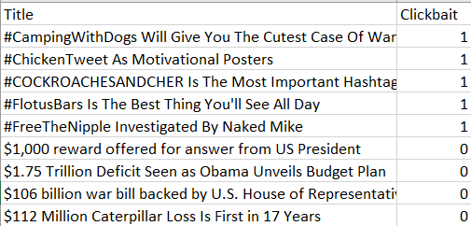
DataSet
Data is sourced from paper “Stop Clickbait: Detecting and Preventing Clickbaits in Online News Media (2016)”
Extensive list of headlines from various sources such as ‘Wikinews’, ‘BuzzFeed’, ‘Upworthy’, ‘ViralNova’, ‘Scoopwhoop’, ‘ViralStories’
Variables
Title: Headlines
Clickbait: dummy-coded as 0 (i.e. not a clickbait) and 1 (i.e. clickbait )
#Observations: 32,000 article titles
16,001 not clickbait article titles
15,999 clickbait article titles

Slide 7
Possible Technical Approaches
Detect clickbaits using fixed set of common clickbait phrases
Not scalable, needs constant tuning with emergence of new clickbaits
Possibility of blocking non-clickbait links
Utilize deep learning models for classification of clickbaits
Improved performance on large datasets compared to traditional machine learning techniques and regression analyses
feature extraction availability
No need for intermediary step of specifying a problem statement for the model
Affords better accuracy of output, particularly for complex problem like Natural Language Processing.

Slide 8
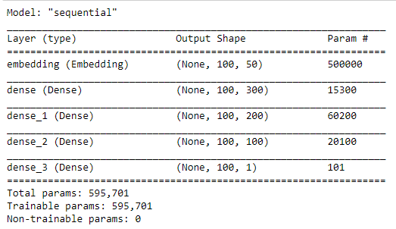
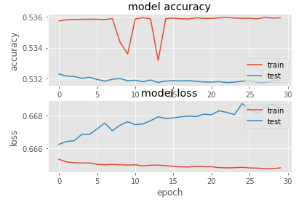
Simple DNN
GloVe embeddings were used; 50 dimensions
3 hidden layers with relu activation
30 epochs, adam optimizer, batch size of 128
Accuracy: 52.39%

Slide 9
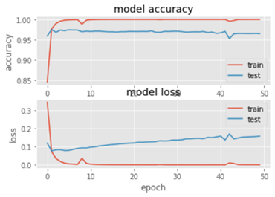
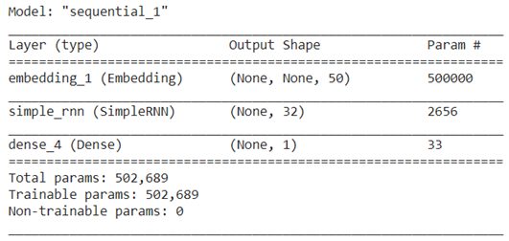
Simple RNN
GloVe embeddings were used; 50 dimensions
1 simple RNN layer with 32 units
50 epochs, adam optimizer, batch size of 128
Accuracy: 97.14%

Slide 10
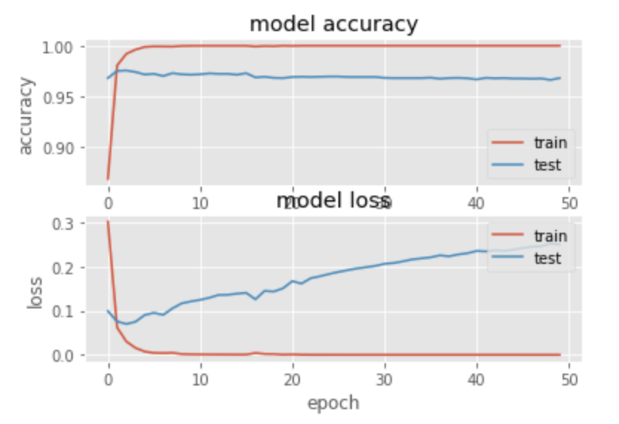
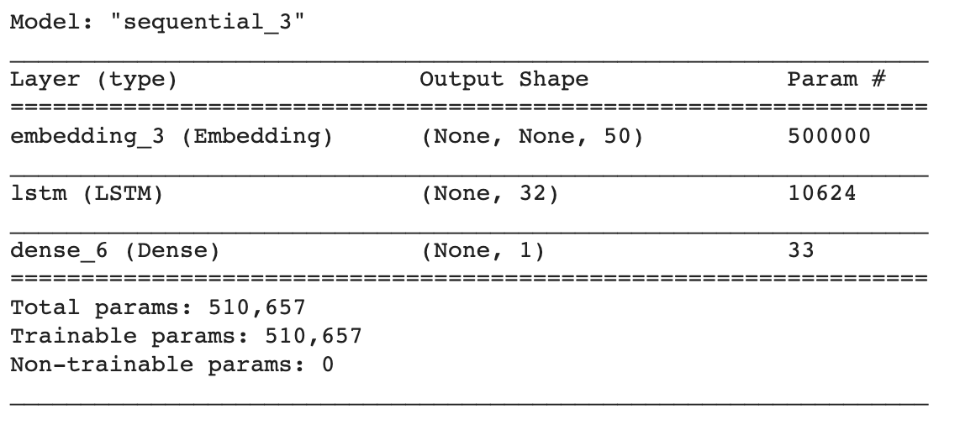
LSTM
GloVe Embedding were used; 50 dimensions
Added LSTM layer with 32 units
‘adam’ optimizer with batch size of 128 units and 50 epochs
Model Accuracy: 97.23%

Slide 11
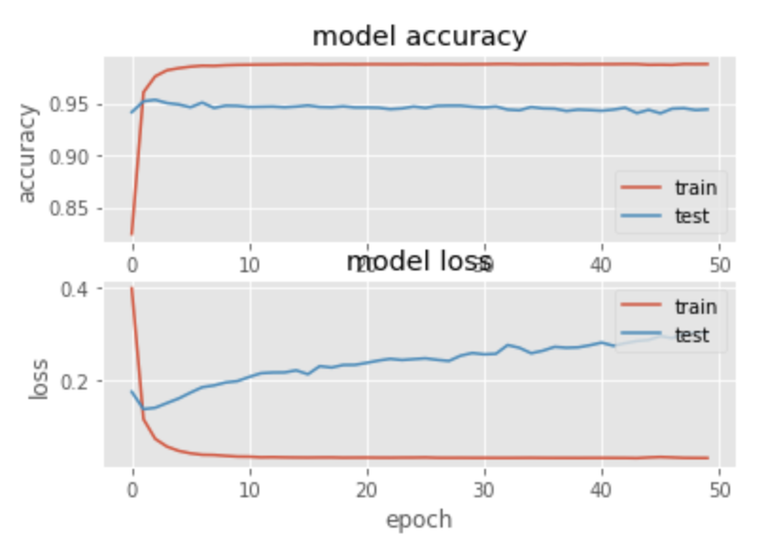
CNN+LSTM
GloVe embeddings used with 50 dimensions
Combination of CNN and LSTM was used
LSTM layer with 32 units and 1-D Convolutional layer with relu activation method
‘adam’ optimizer used with 50 epochs and batch size of 128
Accuracy: 93.91%

Slide 12
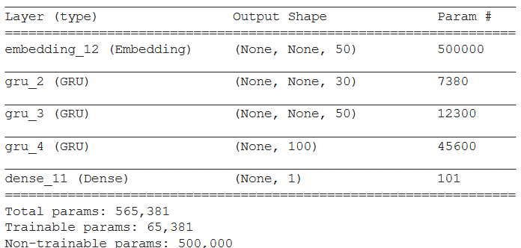
Bidirectional + GRU
Bidirectional: Allows network to get information from past and future steps
GRU: similar to LSTM, but less complex
GloVe embeddings were used; 50 dimensions
3 GRU layers with dropout
70-30 train-test split, 100 epochs, adam optimizer, batch size of 1000
Set | Accuracy | True Positive | True Negative
Train | 97.80% | N/A | N/A
Validation | 97.28% | N/A | N/A
Test | 97.30 | 97.19% | 97.39%

Slide 13
Model Comparison
 | Simple DNN | LSTM | Bidirectional + GRU | Simple RNN | CNN+LSTM
Accuracy | 52.39% | 97.23% | 97.3% | 97.14% | 93.91%
Loss | 0.6692 | 0.1420 | 0.0584 | 0.1417 | 0.3019
Pros | Simple | High accuracy, Great for NLP | High Accuracy, Less complex | High accuracy low level of complexity, | Combines advantages of CNN and LSTM, Helps extracting best features
Cons | Low Accuracy | Long train time, Easy to overfit | Longest train time | Long train time | Long train time

Slide 14
Summary
All models except for DNN performed better than the SVM from the paper
Bidirectional + GRU was the best model with an accuracy of 97.3%, but all types of RNNs had similar accuracies
Neural Networks can perform at equal or better accuracy without having to do any processing like in the previous paper, saving a lot of time and effort
Observation of overfit for CNN+LSTM

Slide 15
References:
A. Chakraborty, B. Paranjape, S. Kakarla and N. Ganguly, "Stop Clickbait: Detecting and preventing clickbaits in online news media," 2016 IEEE/ACM International Conference on Advances in Social Networks Analysis and Mining (ASONAM), 2016, pp. 9-16, doi: 10.1109/ASONAM.2016.7752207.
https://nlp.stanford.edu/projects/glove/

Slide 16
Thank You

